Slide 1
Dev’s Angels (Team 54)
Marco Fiumara (IS) (n9762116), Alice Hendicott (CS) (n9366164), Liam Dale (CS) (n9741283), Christopher Stock (CS) (n9936947), Develyn Evans (IS) (n9723200)

Slide 2
Scrum
“Scrum is an agile way to manage a project, usually software development.”
2-3 Meetings per Week
GitHub tickets
Burndown Chart

Slide 3
objectives
Sprint 1
Layouts – Low Fidelity -> High Fidelity
General Data Analysis
Customer Side features
Sprint 2
Detailed Data Analysis – Graphs, Interactive Features
Refinement of Design
Staff Side Features

Slide 4
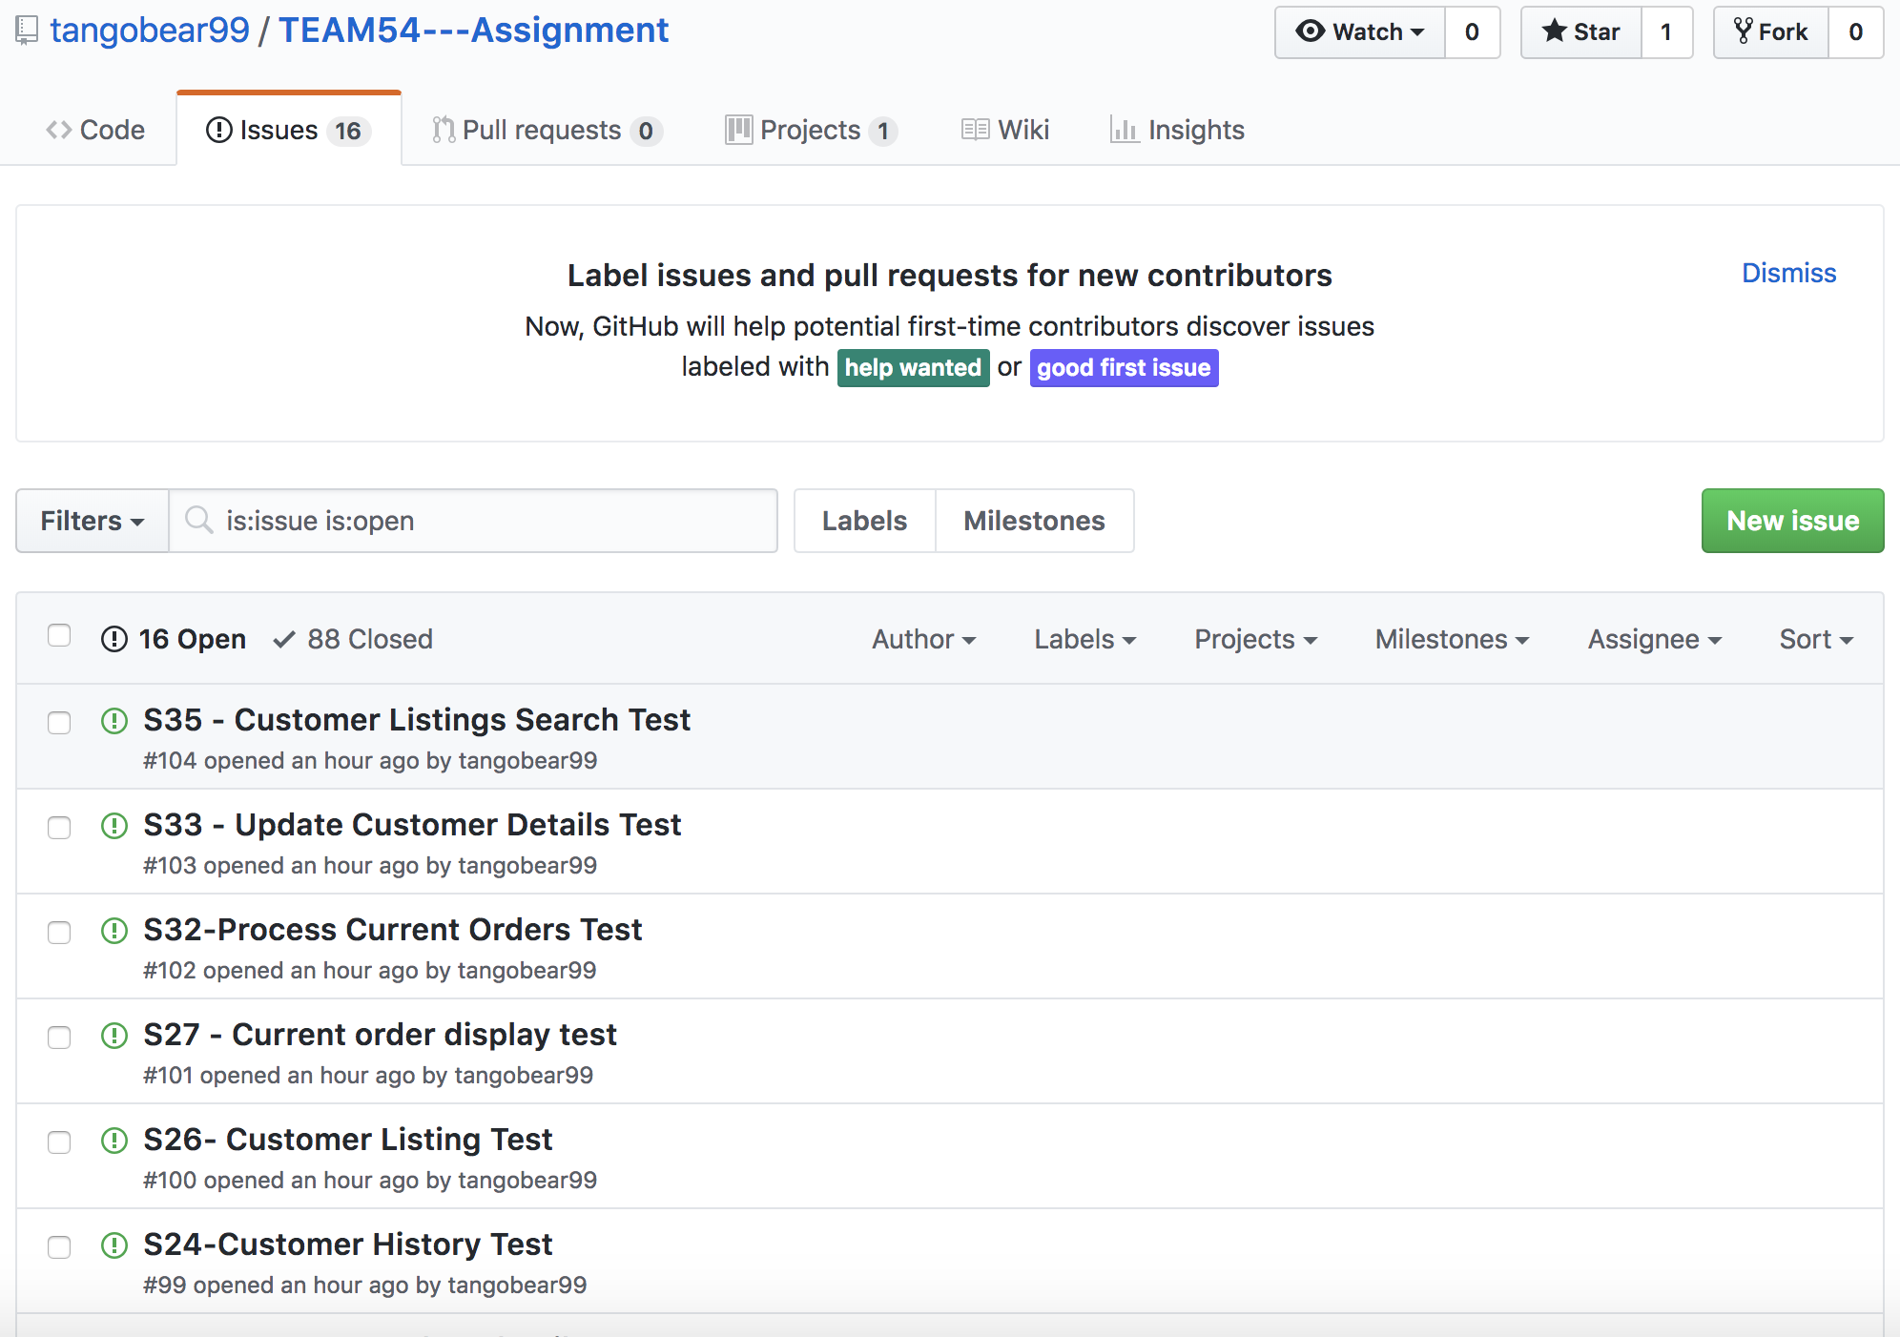
GitHUb issues

Slide 5
Burndown charts: Sprint 1 vs Sprint 2

Slide 6
Sprint & Release
Sprint 1 = ‘Must Have’ and a few ’Should Have’ stories
Sprint 2 = ‘Should Have’ and a few ’Could Have’ stories
Must Haves:
Homepage, Data Analysis Reports, Report Dashboard, Cars & Stores Listing, Recommended Car and Staff Login
Should Haves:
Customised Report, Data Export, Filter & Sort Car List, Customer Feedback, Customer Register, Customer Login, and Customer Listing

Slide 7
Challenges
Stories were ambitious.
Over-complications of acceptance criteria.
Too much dependency on team members.
Underestimation of time limit.
Limited knowledge of Django.

Slide 8
Resolutions
Positive and effective communication.
Being less ambitious with stories.
Played to our strengths.
Weekly meetings.

Slide 9
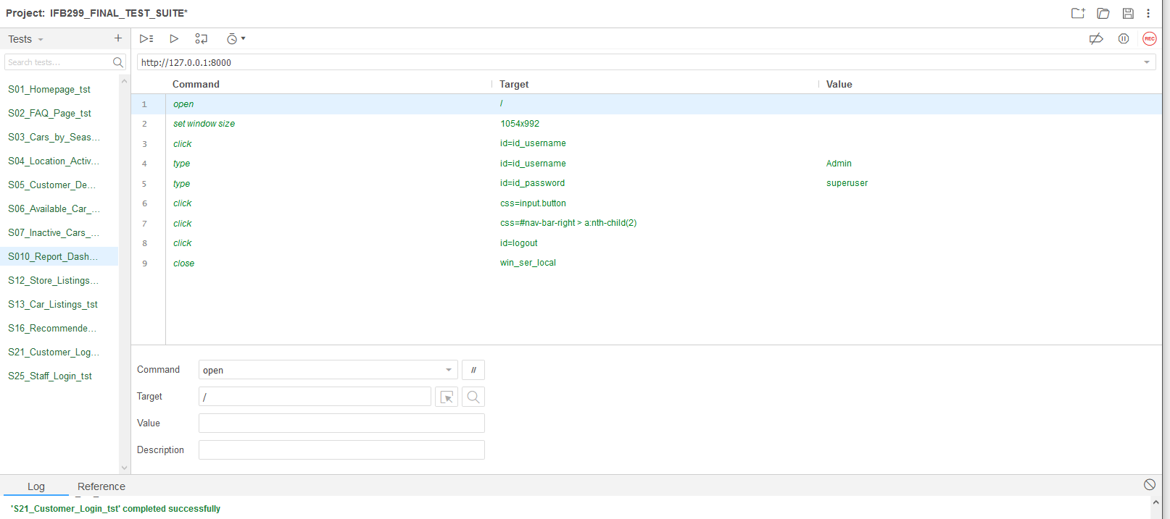
testing

